Slide 1
Graphs - Algorithms and Mining
(DSE** ZG521)

Slide 2
Module I

Slide 3
Course Introduction
COURSE Objectives:
  CO₁: To introduce handling graph data at large scale
  CO₂: To introduce graph mining algorithms and their applications
  CO₃: To enable students to identify and formulate graph mining problems formally, providing solutions
  CO₄: To enable students to evaluate various possible graph mining solutions for a given problem

Slide 4
Resources
TEXT BOOKS (T1 & T2):
Social Media Mining - An introduction, Reza Zafarani, Mohammad Ali Abbasi, Huan Liu , Cambridge University Press , 2014 [ http://dmml.asu.edu/smm/SMM.pdf - Open Access]
Not all topics are covered in one text/reference book.
* Research Papers will be used for most of the topics.
* Most of the contents are theoretical, but their practical application will be explained.
* Research Paper will also be provided to you, for your better understanding

Slide 5
Resources
REFERENCE BOOKS (R):
(R1) Agarwal Charu C. and Wang Haixun, “Managing and Mining Graph Data” , Springer; 2010 edition.
(R2) Jure Leskovec, Anand Rajaraman, Jeff Ullman. “Mining of Massive Datasets”. Book 2nd edition. Cambridge University Press.
(R3) Tan P. N., Steinbach M & Kumar V. “Introduction to Data Mining” Pearson Education, 2006

Slide 6
EVALUATION SCHEME
EC No | Component & Nature | Duration | Weightage | Date, Time
1. | Quiz 1 | - | 5% (Best of the Two)
1. | Quiz 2 | -
1. | Assignment 1 | - | 25%
2. | Mid-Semester Test (Closed Book) | 2 hours | 30%
3. | Comprehensive Exam (Open Book) | 3 hours | 40%

Slide 7
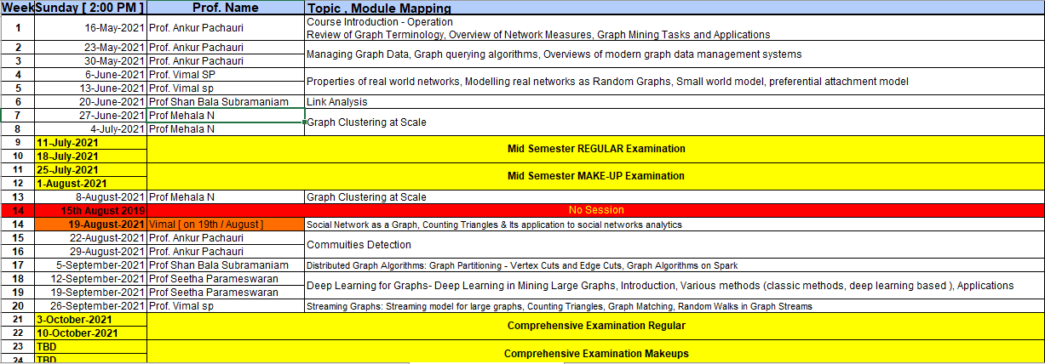
Delivery Plan

Slide 8
Faculty Details
S.No | Name of Professor | Contact Details
1 | Prof Shan Bala Subramaniam | sundar.balasub@gmail.com
2 | Prof Vimal SP | vimalsp@pilani.bits-pilani.ac.in
3 | Prof Seetha Parameswaran | seetha.p@pilani.bits-pilani.ac.in
4 | Prof Mehala N | mehalan@wilp.bits-pilani.ac.in
5 | Prof Ankur Pachauri | ankur.pachauri@Pilani.bits-Pilani.ac.in 9927590910

Slide 9
Few Requests
Email etiquettes.
No “reply to all”; unless & until unavoidable!
No Request to timeline extension, with the reason of being working professionals.
Continuous reading of papers & books.

Slide 10
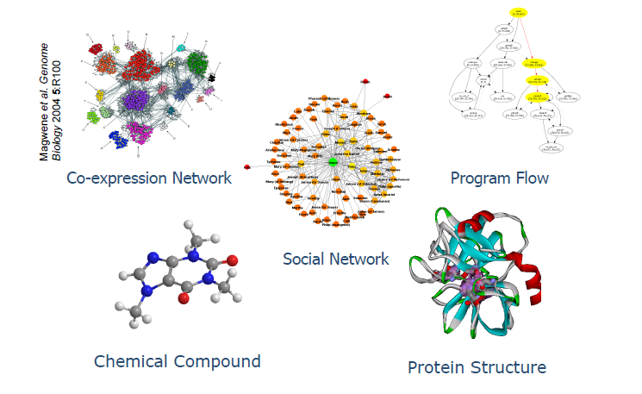
Various type of Graph Data for Graph Mining

Slide 11
Course Outline
Introduction to the Graphs
  Preliminaries
Graph Mining Applications
Overview of Graph mining Algorithms
  Graph Data Management Algorithms
    Indexing
    Querying
      Reachability
      Matching
      Searching
      Summarization
  Dynamics of Dynamic Graphs (Time Evolving Graphs)
    Densification
    Radius & Diameter of graph

Slide 12
Course Outline ….
Graph Mining Algorithms
  Pattern Mining
  Clustering
    Node Clustering
    Graph Clustering
  Classification
    Label Propagation
    Graph Classification
  Graph Compression
  Other important topics
    (graph model, laws, graph dynamics, social network analysis, visualization, summarization, graph clustering, link analysis, …)

Slide 13
Prerequisite
Graph Terminologies.
  Nodes
  Edges
  Degree and Degree distribution
  Weighted - unweighted,
  Storage of graph: Matrix-list..
  Tree, Forest, Spanning tree
  Traversal: DFS, BFS
  Paths, Connected – disconnected

Slide 14
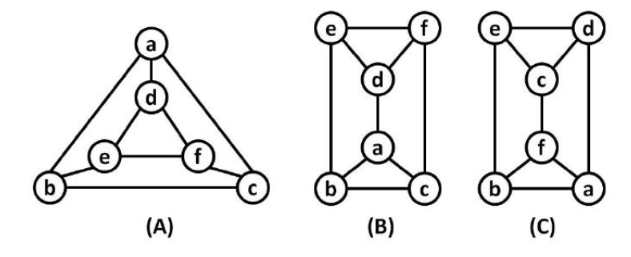
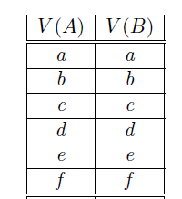
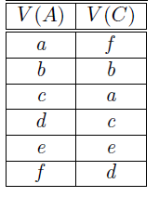
Prerequisite
NP Complete Problems.
Graph Isomorphism.
Graph Matching.
  Edit Distance
Sub Graph Isomorphism.
Graph Summarization
  Google Maps example
Graph Partitioning
  Cut Vertex
  Cut Edge
  Bipartite graph

Slide 15
Prerequisite….
Random Walk
Cliques
Planar & Non Planar Graphs.
Pattern Matching.
Disk Resident Graphs.
  Why the algorithms using random edges/nodes are not suitable for disk resident graphs
Graph Connectivity,
  Max Flow - Min Cut
Connected Components
  Largest Connected Components
Lowest common ancestor.
……

Slide 16
Topics for Assignments/Presentation
Graph Isomorphic algorithms
Diameter & Reachability calculation algorithm
Topic sensitive page rank algorithm
SimRank algorithm
Kerninghan-Lin algorithm & The Girvan-Newman Algorithm
gSpan Algorithm

Slide 17
Assignment #1
Write short notes on each of the graph algorithms named.
Solve (through Dry Run), atleast one graph problem of size not less than 10 nodes, for each of the algorithm. (use internet and your previous text books for algorithms or pseudocode)
Submit individually (on portal) on or before
No extension of any timeline unless our server is down.

Slide 18
Types of Graph Algorithms
The Graph algorithms are broadly classified in two different cases:
  Multiple graphs
    Chemical data
    Biological data
  Single Large Graph
    Web Graph
    Social media graphs

Slide 19
Quick recap
What is the difference between:
  A tree and a spanning tree?
  A spanning tree and Minimum spanning tree.
For what NP stands for and what does it mean?
What are disk resident graphs and what is its limitation, and why?

Slide 20
Various type of Data for Graph Mining
Search “image.Google” for various types of large graphs

Slide 21
Various type of Data for Graph Mining
Chemical Data: Often represented as graphs in which the nodes correspond to atoms, and the links correspond to bonds between the atoms.
  In some cases, substructures of the data may also be used as individual nodes.
  Such as Benzene rings
  Polymers
  The individual graphs are quite small, though there are significant repetitions among the different nodes. This leads to isomorphism challenges in applications such as graph matching.

Slide 22
Various type of Data for Graph Mining
Biological Data: Similar way as chemical data. However, the individual graphs are typically much larger. Furthermore, the nodes are typically carefully designed portions of the biological models
  Such as Proteins
    Amino acids
      A, T, G,C in DNA
      A, U, G, C in RNA
      Dominance and recessive property of Genes
        Mendel's experiment
A single biological network could easily contain thousands of nodes. The sizes of the overall database are also large enough for the underlying graphs to be disk-resident.

Slide 23
Various type of Data for Graph Mining
Computer Networked and Web Data: The number of nodes in the underlying graph may be massive as well as edges. (massive domain issue in networked data.)
    it may be hard to hold in the available storage space.
      So we need to be designed some techniques to summarize and work with condensed representations of the graph data sets.
        Google maps….
    The edges may also arrive in the form of a data stream.
      A new challenge arises, it may not be possible to store the incoming edges for future analysis.
      Therefore, the summarization techniques and the stream summaries may be leveraged for future processing of the underlying graphs.

Slide 24
Various type of Data for Graph Mining
XML data :Complex and semi-structured data is often represented in the form of XML documents
XML data is a natural form of labelled graph data.
Mining and management algorithms for XML data are also quite useful for graph data,
In addition, the attribute-value combinations associated with the nodes makes the problem much more challenging.
  Since it is much more difficult to design mining and management operations for structured data.

Slide 25
Application of Graph Mining

Slide 26
Application Of Graph Mining
The field of graph mining has seen a rapid explosion in recent years because of new applications in
  Computational biology
    Includes Bioinformatics.
    Is the science of using biological data to develop algorithms or models to understand biological systems and relationships

Slide 27
Computational biology (Subfields)
Computational anatomy
  A subfield of medical imaging (such as MRI) and bioengineering
Computational biomodeling
  Field concerned with building computer models of biological systems.
  Develop and use visual simulations in order to assess the complexity of biological systems.
  These models allow for prediction of how systems will react under different environments.
Computational genomics (Computational genetics)
  It is sometimes referred to as Computational and Statistical Genetics and encompasses much of Bioinformatics. The Human Genome Project is one example of computational genomics.
Source Wikipedia

Slide 28
Computational biology (Subfields).…
Computational neuroscience
  Computational neuroscience is the study of brain function in terms of the information processing properties
    Realistic Brain Models:
    Simplifying Brain Models:
Computational pharmacology
  the study of the effects of genomic data to find links between specific genotypes and diseases and then screening drug data
Computational evolutionary biology
  Using DNA data to reconstruct the tree of life with computational phylogenetics
  Fitting population genetics models (either forward time or backward time) to DNA data to make inferences about demographic or selective history.
Source Wikipedia

Slide 29
Computational biology (Subfields)….
Cancer computational biology
  Aims to determine the future mutations in cancer through an algorithmic approach to analyzing data.
Computational neuropsychiatry
  uses mathematical and computer-assisted modeling of brain mechanisms involved in mental disorders.
Source Wikipedia

Slide 30
Application Of Graph Mining
The field of graph mining has seen a rapid explosion in recent years because of new applications in
  Chemical data analysis (Structure Activity Relationship (SAR) principle)
    Behaviour of chemical compound,
      Property of any compound is based on its structural composition.
    Drug Discovery
      Thus, graph mining may help reveal chemical and biology characteristics to facilitate the process of drug design such as:
        activity, toxicity, absorption, metabolism, etc. [1],
[1] H.J. Bohm, G. Schneider. Virtual Screening for Bioactive Molecules. Wiley-VCH, 2000.

Slide 31
Application Of Graph Mining
The field of graph mining has seen a rapid explosion in recent years because of new applications in
  Chemical data analysis (Structure Activity Relationship (SAR) principle)
    Fundamental operations is similarity search for
      Rankretrieval: searching a large database to find chemical compounds that share the same bioactivity as a query compound;
      scaffold-hopping: finding compounds that have similar bioactivity but different structure from the query compound.

Slide 32
Application Of Graph Mining
The field of graph mining has seen a rapid explosion in recent years because of new applications in
  Chemical data analysis (Structure Activity Relationship (SAR) principle)
    Fundamental operations is similarity search
Identify compounds that are good “replacement” for the query compound, which either has some undesirable properties (e.g., toxicity), or is from the existing patented chemical space.
  Since chemical structure determines bioactivity (the SAR principle), scaffold- hopping is challenging, as the identified compounds must be structurally similar enough to demonstrate similar bioactivity, but different enough to be a novel chemotype.

Slide 33
Application Of Graph Mining
The field of graph mining has seen a rapid explosion in recent years because of new applications in
  Chemical data analysis (Structure Activity Relationship (SAR) principle)
Structure-driven prediction: to predict about any chemical based on its structure, i.e. active or inactive, toxic or nontoxic, etc.
  SVM (Support Vector Machines) based methods have proved effective for this task.
Target-based drug discovery: starts in late 1980's, Its goal is to develop a drug that selectively modulates the effects of the disease-associated gene or gene product without affecting other genes or molecular mechanisms in the organism. This is made possible by the High Throughput Screening (HTS) technique, which is able to rapidly testing a large number of compounds based on their binding activity against a given target.

Slide 34
Application Of Graph Mining
The field of graph mining has seen a rapid explosion in recent years because of new applications in
  Software bug localization
    is an important application from the perspective of software reliability and testing.
    The control flow of programs can be modelled in the form of call-graphs (CFD & DFD).
    The goal of software bug localization techniques is to mine such call graphs in order to determine the bugs in the underlying programs.
    Call graphs are of two types:
      Static call graphs
      Dynamic call graphs

Slide 35
Application Of Graph Mining
The field of graph mining has seen a rapid explosion in recent years because of new applications in
  Software bug localization
    Static call graphs can be inferred from the source code of a given program. All the methods, procedures and functions in the program are nodes, and the relationships between the different methods are defined as edges.
    Dynamic call graphs are created during program execution, and they represent the invocation structure.
    Such call graphs can be extremely large in massive software programs, because of thousands of invocations between different procedures. In such cases, the difference in structural, frequency or sequence behaviour of successful and failing invocations can be used to localize software bugs.
    Such call graphs can be particularly useful in localizing bugs which are occasional in nature and may occur in some invocations and not others.

Slide 36
Application Of Graph Mining
The field of graph mining has seen a rapid explosion in recent years because of new applications in
  Software bug localization
    Logical errors in a program which are not a result of the program structure, and which do not affect the sequence or structure of execution of the different methods cannot be localized with such techniques.
    software bug localization is not an exact science. Rather, it can be used in order to provide software testing experts with possible bugs, and they can use this in order to make relevant corrections.

Slide 37
Application Of Graph Mining
The field of graph mining has seen a rapid explosion in recent years because of new applications in
  Social and Communication networking
    The World Wide Web (WWW) is naturally structured in the form of a graph with nodes as web pages and the links are the edges.
    The linkage structure of the web holds a wealth of information which can be exploited for a variety of data mining purposes.
    The most famous application which exploits the linkage structure of the web is the PageRank algorithm.
    This algorithm has been one of the key secrets to the success of the well known Google search engine.

Slide 38
Application Of Graph Mining
The field of graph mining has seen a rapid explosion in recent years because of new applications in
  Social and Communication networking
    PageRank algorithm.
      The basic idea is that the importance of a page on the web can be gauged from the number and importance of the hyperlinks pointing to it.
      The intuitive interpretation of page rank is the probability that a random surfer arrives at a given web page during a random walk.
      Thus, it forms a probability distribution over web pages, so that the sum of the page rank over all the web pages sums to 1, with teleportation, in which we can transition any web page in the collection uniformly at random.

Slide 39
Application Of Graph Mining
The field of graph mining has seen a rapid explosion in recent years because of new applications in
  Social and Communication networking
    PageRank algorithm.
      The page-rank algorithm only looks at the link structure during the ranking process, and does not include any information about the content of the underlying web pages.
      A closely related concept is that of topic-sensitive page rank [2], in which we use the topics of the web pages during the ranking process.
      Page rank is inherently a dynamic problem.
[2] T. Haveliwala. Topic-Sensitive Page Rank, World Wide Web Conference, 2002.

Slide 40
Application Of Graph Mining
The field of graph mining has seen a rapid explosion in recent years because of new applications in
  Social and Communication networking
  Social networks are very large graphs which are defined by people who appear as nodes, and links which correspond to communications or relationships between these different people. The links in the social network can be used to
    Determine relevant communities
    Members with particular expertise sets, and
    The flow of information in the social network.

Slide 41
Application Of Graph Mining
The field of graph mining has seen a rapid explosion in recent years because of new applications in
  Social and Communication networking
  Social networks are very large graphs which are defined by people who appear as nodes, and links which correspond to communications or relationships between these different people. The links in the social network can be used to
    Determine relevant communities
      It is related to the problem of node clustering of very large graphs.
      It is particularly interesting in the context of dynamic analysis of evolving networks in which we try to determine how the communities in the graph may change over time.
      newly forming communities, decaying communities, or evolving communities.

Slide 42
Application Of Graph Mining
Members with particular expertise sets, &The flow of information in the social network
  Centrality analysis in networks is closely related to the problem of information flow spread in social networks.
    To determine the most influential members of the social network;
    Information in the social behaviour often cascades through it in the same way as an epidemic. We would like to measure the information cascade rate through the social network, and determine the effect of different sources of information.

Slide 43
Overview of Graph mining Algorithms

Slide 44
Overview of Graph mining Algorithms
Graph mining has been studied by the theoretical community extensively in the context of numerous problems such as
  Graph Partitioning,
  Node Clustering,
  Graph Matching, and
  Connectivity Analysis.

Slide 45
Real Time Scenarios with Graph Mining
It cannot be directly used in practical applications because:
  The definitions of problems are too “clean” to be used with real applications in graph partitioning, matching and dimensionality reduction.
  In real applications, the problem may have different variations such as a
    Disk-resident case,
    A Multi-Graph case, or
    Other constraints associated with the graphs.
  In many problems, it may have a variety of different flavours for different scenarios, such as
    Frequent sub-graph mining and
    Dense graph mining.

Slide 46
Real Time Scenarios with Graph Mining
It cannot be directly used in practical applications because:
  The size of the applications in real scenarios are often very large.
    In such cases, the graphs may not be stored in main memory, but may be available only on disk.
      A classic example of this is the case of web and social network graphs, which may contain millions of nodes. As a result, it is often necessary to design specialized algorithms which are sensitive to disk access efficiency constraints.
    In some cases, the entire graph may not be available at one time, but may be available in the form of a continuous stream. This is the case in many applications such as social and telecommunication networks in which edges are received continuously.

Slide 47
Real Time Scenarios with Graph Mining
It is assumed that the underlying graphs are massive and cannot be held in main memory.
In many cases, the problem of graph management and mining has been studied from the perspective of structured and XML data.
Many of the graph algorithms are sensitive to the application scenario in which they are encountered.
Different application result in different kind of graphs and corresponding challenges are also quite different.

Slide 48
Overview of Graph mining Algorithms
Graph Management Algorithms:
  Algorithms for managing and indexing large volumes of the graph data.
    We will study algorithms for indexing of graphs and processing of graph queries.
      Algorithms for reachability queries
      Algorithms for matching graphs and their applications.
Graph Mining Algorithms:
  Algorithms used to extract_____ from Graphs.
    Patterns
    Trends
    Classes
    Clusters
    Storage and access the large graphs on the disk

Slide 49
Graph Management Algorithms
Graph Management Algorithms:
  Data management of graphs is much more challenging than multi-dimensional data.
  The structural representation of graphs has greater expressive power, but it comes at a cost of:
    Complexity of Data Representation
    Access
    Processing,
      Because of intermediate operations such as
        Similarity Computations,
        Averaging
        Distance Computations
      These cannot be naturally defined for structural data in as intuitive a way as is the case for multidimensional data.

Slide 50
Graph Management Algorithms
Graph Management Algorithms:
Indexing & Querying
  The current traditional query languages (eg. SQL) lack the way to query Graphs and Trees. So some Graph Query Language (Graph QL[3]) have been proposed.
  For a query pattern (a tree or a graph), find graphs or trees in the database that contain or are similar to the query pattern.
  To accomplish this task elegantly and efficiently, we need to address several important issues:
    How to model the data and the query;
    How to store the data; and
    How to index the data for efficient query processing.
[3] H. He, “Querying and mining graph databases”. Ph.D. Thesis, UCSB, 2007.

Slide 51
Graph Management Algorithms
Graph Management Algorithms:
Reachability
  Whether there is a path from a node v to another node u in a large directed graph and it is the basic operation for many queries.
    we traverse the graph starting from node v using BFS or DFS to check we can ever reach node u. O(n +m), OR
    We compute and store the edge transitive closure of the graph. which requires O(n²) storage, a reachability query can be answered in O(1) time by simply checking whether (u, v) is in the transitive closure.
  However, for large graphs, neither of the two methods is feasible:
    The first method is too expensive at query time, and
    The second takes too much space.

Slide 52
Graph Management Algorithms
Graph Management Algorithms:
Reachability
  Spanning tree based approaches
  The complete graph is divided into two set of edges, spanning tree edge and non tree edges and each edge is assigned a interval_code/timestamp/counter.
  Easy to check for reachability between two tree edges.
  For non tree edges, we need to check if there is a path that involves non-tree edges connecting the two nodes. By building a index structures in addition to the interval_code/timestamp/counter. to speed up the reachability check.

Slide 53
Example
  Spanning tree based approaches
I
A
G
B
H
C
F
J
D
E

Slide 54
Graph Management Algorithms
Graph Management Algorithms:
Reachability
  Set covering based approaches
  pairwise disjoint chains
    Jagadish et al. [4] proposes to decompose a graph into pairwise disjoint chains, and then use chains to cover the graph.
    The intuition of using chain is similar to using a tree: if v can reach u on a chain, then v can reach any node that comes after u on that chain.
    The chain-cover approach achieves O(nk) query time, where k is the number of chains in the graph.
[4] H. V. Jagadish. A compression technique to materialize transitive closure. ACM Trans. Database Syst., 15(4):558–598, 1990..

Slide 55
Example
  pairwise disjoint chains
I
A
G
B
H
C
F
J
D
E

Slide 56
Graph Management Algorithms
Graph Management Algorithms:
Reachability
  Set covering based approaches
  2-hop Cover
    Cohen et al.[5] proposed a 2-hop cover for reachability queries. A node u is labelled by two sets of nodes, called L_{in}(u) & L_{out}(u), where L_{in}(u) are the nodes that can reach u and L_{out}(u) are the ones that u can reach.
    The 2-hop approach assigns the L_{in} and L_{out} labels to each node such that u can reach v iff L_{out}(u) ∩ L_{in}(v) != ∅.
    A greedy algorithm finds a 2-hop cover iteratively.
[5] E. Cohen, E. Halperin, H. Kaplan, U. Zwick. Reachability and Distance Queries via 2-hop Labels, ACM Symposium on Discrete Algorithms, 2002.

Slide 57
Example
2 hop
I
A
G
B
H
C
F
J
D
E

Slide 58
Graph Management Algorithms
Graph Management Algorithms:
Graph Matching
  Finding either an approximate or a one-to-one correspondence among the nodes of the two graphs.
    The labels on the nodes in the two graphs should be the same.
    The existence of edges between corresponding nodes in the two graphs should match each other.
    The labels on the edges in the two graphs should match each other.

Slide 59
Graph Management Algorithms
Graph Management Algorithms:
Graph Matching
  Exact graph matching
    Exact matching may not be feasible, The problem of exact graph matching is closely related to that of graph isomorphism.
  Inexact graph matching
    Finding the maximal common subgraph in which we attempt to match the maximum number of nodes between the two graphs.
  Most variants of the graph matching problem are well known to be NP-hard.

Slide 60
Graph Management Algorithms
Graph Management Algorithms:
Graph Matching
  Inexact graph matching
    A method of edit distance is required in order to quantify these errors and the closeness between the different graphs.
    The graph edit distance determines the distance between two graphs by measuring the cost of the edits required to transform one graph to the other.
    These edits may be node or edge insertions, deletions or substitutions.
    The concept of graph edit distance is closely related to that of finding a maximum common subgraph.

Slide 61
Graph Management Algorithms
Graph Management Algorithms:
Keyword Search
  Determine small groups of link-connected nodes which are related to a particular keyword.
  It provides a simple but user-friendly interface for information retrieval on the Web.
  Because the underlying data assumes a graph structure, keyword search becomes much more complex than traditional keyword search over documents.

Slide 62
Graph Management Algorithms
  The challenges lie in three aspects:
  Query semantics:
    Keyword search over a set of text documents has very clear semantics. A document satisfies a keyword query if it contains every keyword in the query and return subgraphs as answers.
  Ranking strategy:
    For a given keyword query, it is likely that many subgraphs will satisfy the query we must take the graph structure into consideration and design ranking strategies that find most meaningful and relevant answers.
  Query efficiency:
    Many real life graphs are extremely large. A major challenge for keyword search over graph data is query efficiency, which, to a large extent, hinges on the semantics of the query and the ranking strategy.

Slide 63
Graph Management Algorithms
Graph Management Algorithms:
Synopsis Construction of Massive Graphs
  The graph on which we will work is a very large graph, which may not be available of the in the primary memory and can only be available on disk.
    In this case the applications which access the edges in random order may be extremely expensive.
    A typical technique which may be used is a synopsis construction technique, which summarizes the graph in a much smaller space, but retains sufficient information in order to effectively respond to queries, by using either node or edge contractions.

Slide 64
Graph Management Algorithms
Graph Management Algorithms:
Synopsis Construction of Massive Graphs
  The second situation can be with mining Graph Stream.
    The edges of the graph are received continuously over time, as in social networks, communication networks, and web log analysis.
    Graph streams are very challenging to mine, because the structure of the graph needs to be mined in real time.
    We summarize the graph in such a way that the underlying distance is preserved.

Slide 65
Graph Mining Algorithms
Graph Mining Algorithms:
  Are more challenging to implement due to additional constraints which arise from the structural nature of the underlying graph.
  Frequent pattern mining
    Finding subgraphs
  Clustering
    Dense subgraph extraction
      Graph Partitioning
      Minimum cut problem
  Classification
    Node labelling
    Graph labelling

Slide 66
Graph Mining Algorithms
Frequent pattern mining
  Traditionally studied in the context of mining transactional data.
  In Graph data
    Either finding all patterns which support a fraction of the corresponding group of graphs.
    Or all patterns which are supported at least a certain number of times in a single large graph.
  In both cases, we need to account for the isomorphism issue in determining whether one graph is supported by another and has been found to be useful in the chemical and biological domain

Slide 67
Graph Mining Algorithms
Clustering
  congestion detection,
  facility location
  XML data integration
Node Clustering Algorithms:
  We have one large graph, and we attempt to cluster the underlying nodes with the use of a distance (or similarity) value on the edges.
  The problem of minimizing the inter-cluster similarity for a fixed number of clusters reduces to the problem of multi-way graph partitioning (NP-Hard) or the minimum multi-way cut problem.
    It is desired to partition the graph in such a way so as to minimize the weights of the edges across the partitions.
  This is also referred to as the problem of mining dense graphs and pseudo-cliques.
Notes:
The problem is efficiently solvable, and can be resolved by repeated applications of the maximum flow problem. This is because the maximum flow between source s and sink t determines the minimum s-t cut. By using different source and sink combinations, it is also possible to find the global minimum cut.

Slide 68
Graph Mining Algorithms
Clustering
  congestion detection,
  facility location
  XML data integration
Graph Clustering Algorithms:
  In this case, we have a (possibly large) number of graphs which need to be clustered based on their underlying structural behaviour.
  This problem is challenging because of the need to match the structures of the underlying graphs, and use these structures for clustering purposes.

Slide 69
Graph Mining Algorithms
Classification
  Classification is a central task in data mining and machine learning.
  Used in pharmaceutics and drug design, we are interested to know the relationship between the activity of a chemical compound and the structure of the compound, which is represented by a graph.
  Label Propagation.
    A subset of nodes in a graph are labelled. The task is to learn a model from the labelled nodes and use the model to classify the unlabelled nodes.
  Graph classification.
    A subset of graphs in a graph dataset are labelled. The task is to learn a model from the labelled graphs and use the model to classify the unlabelled graphs.

Slide 70
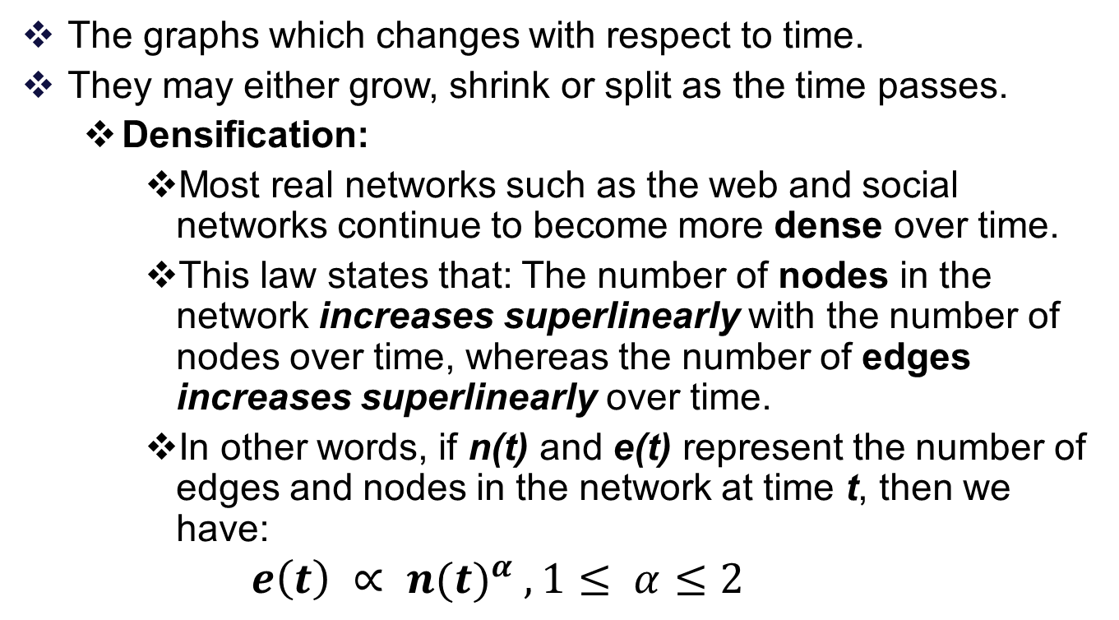
Dynamics of Dynamic Graphs (Time Evolving Graphs)
The graphs which changes with respect to time.
They may either grow, shrink or split as the time passes.
  Densification:
    Most real networks such as the web and social networks continue to become more dense over time.
    This law states that: The number of nodes in the network increases superlinearly with the number of nodes over time, whereas the number of edges increases superlinearly over time.
    In other words, if n(t) and e(t) represent the number of edges and nodes in the network at time t, then we have:
    $$e\left(t\right) ∝ {n(t)}^{α} , 1≤ α≤2$$

Slide 71
Dynamics of Dynamic Graphs (Time Evolving Graphs)
The graphs which changes with respect to time.
They may either grow, shrink or split as the time passes.
  Shrinking Diameters:
    The small world phenomenon of graphs is well known.
    It was shown by researchers [6] that the average path length between two MSN messenger users is 6.6.
    This can be considered a verification of the (internet version of the) widely known rule of “six degrees of separation” in (generic) social networks.
[6] J. Leskovec, E. Horvitz. Planetary-Scale Views on a Large Instant Messaging Network, WWW Conference, 2008.

Slide 72
Dynamics of Dynamic Graphs (Time Evolving Graphs)
The graphs which changes with respect to time.
They may either grow, shrink or split as the time passes.
  Shrinking Diameters:
    It was further shown in [7], that the diameters of massive networks such as the web continue to shrink over time.
    The edges are added more rapidly to the network than nodes.
    As more edges are added to the graph it becomes possible to traverse from one node to another with the use of a fewer number of edges.
[7] J. Leskovec, J. Kleinberg, C. Faloutsos. Graphs over time: Densification laws, shrinking diameters and possible explanations. ACM KDD Conference , 2005.

Slide 73
Dynamics of Graphs
Graphs which arise in many large scale applications such as the web and social networks satisfy many properties such as
  The power law distribution
  Sparsity, and Small Diameters
  Densification, and Shrinking Diameters

Slide 74
Reference
D. Cook, L. Holder, Mining Graph Data, John Wiley & Sons Inc, 2007.
Agarwal Charu C. and Wang Haixun, “Managing and Mining Graph Data”, 2010.

Slide 75
Thank You

